Slide 1

Multi-variable calibration of a conceptual rainfall-runoff model in the selected Alpine catchments
Snow an ecological phenomenon
19.-21.9.2017
Patrik Sleziak, Ján Szolgay, Kamila Hlavčová, Juraj Parajka
Slovak University of Technology in Bratislava,
Department of Land and Water Resources Management

Slide 2
Introduction
In alpine (mountainous) regions snow is an important runoff generation process.
In these regions the correct parametrisation of hydrological processes (e.g. SWE) in r-r models is crucial (data are sparse, etc.).
One of the possible approach to overcome limitations is to use the additional data to calibrate models, e.g. groundwater data (Madsen, 2003), soil moisture data (Parajka et al., 2009), snow cover data (Parajka et al., 2007).

Slide 3
The aim of the study
To assess the effects of different objective functions (single-objective approach – SINGLE and multi-objective approach – MULTI) on the performance of the r-r model.
Research questions:
What is the benefit of use of snow cover data in hydrologic model calibration?
Does a multi-objective approach perform better than a single-objective in terms of simulation of Q and SWE?

Slide 4
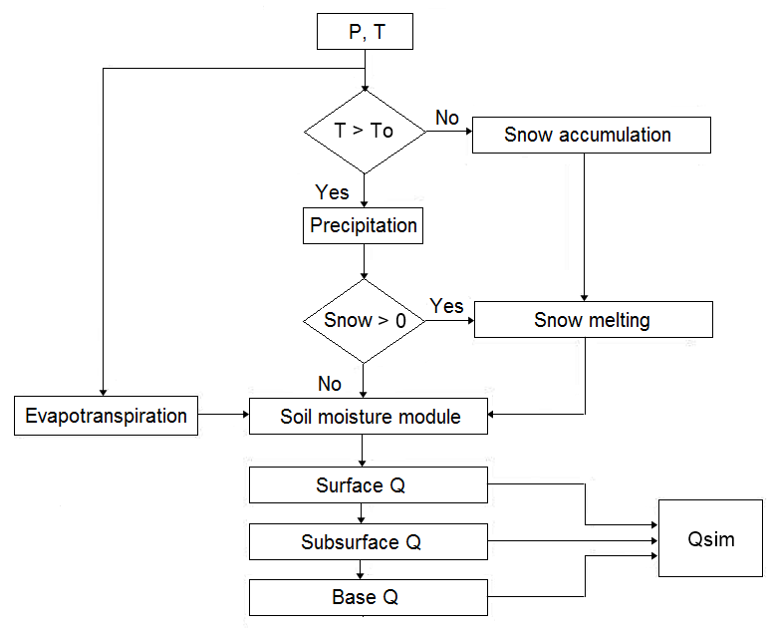
TUW model
conceptual HBV type r-r model,
developed at TU Wien
(Viglione a Parajka, 2014),
15 parameters,
three modules: snow, soil moisture and runoff
module (Merz, Blöschl, 2004).
Fig. Scheme of the HBV model (Bergstrom, 1995).

Slide 5
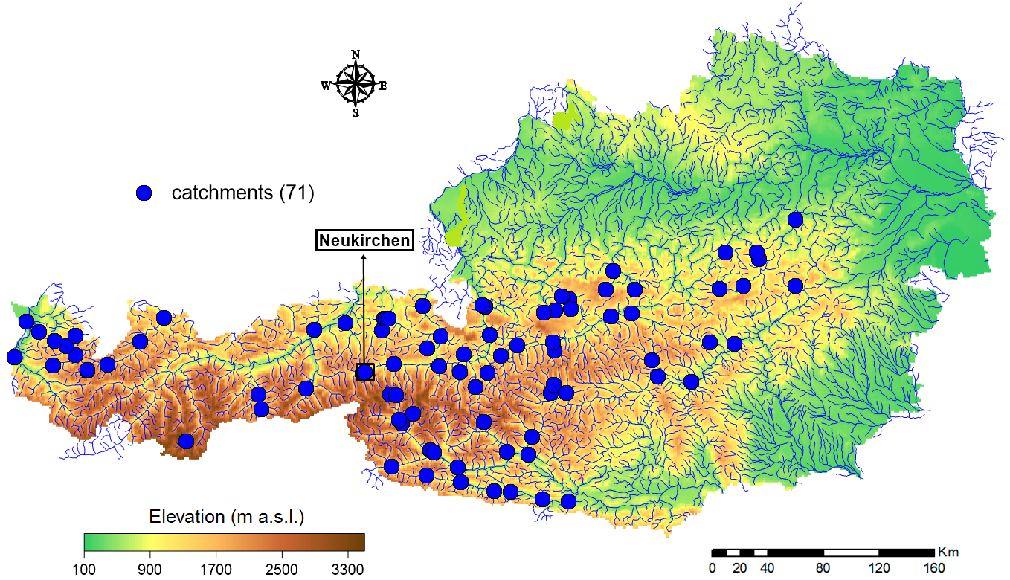
Study area and data
The study was carried out in Austria using daily data (P, T, EP, Q) from the period 1981 – 2010.
71 catchments,
Area: 14 – 6214 km²,
Elevation: 984 – 2915 m a.s.l.,
P: 1048 – 2313 mm/year,
T: from -2.1 to 6.1 °C,
Q: 555 – 2662 mm/year.
Fig. Map of Austria with the selected gauging stations and the selected pilot catchment.

Slide 6
Calibration and validation strategy
Tab. Scheme of the modelling.
Period | 1981-1990 | 1991-2000 | 2001-2010
1981-1990 | Calibration | Validation | Validation
1991-2000 | Validation | Calibration | Validation
2001-2010 | Validation | Validation | Calibration
DSST (Klemeš, 1986),
algorithm: Deoptim (Swagatam et al., 2011),
performance assessment: NSE (Nash a Sutcliffe, 1970), VE (Merz et al., 2011), SN (Parajka et al., 2007).

Slide 7
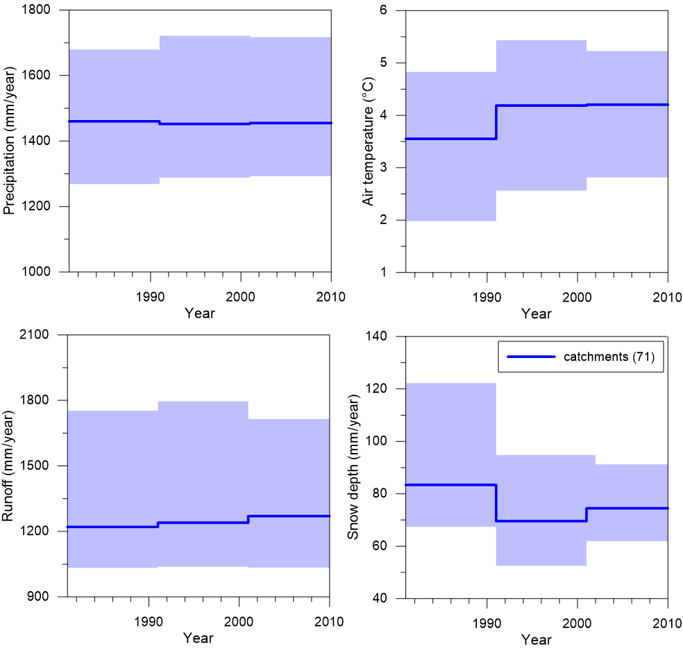
Climatic characteristics in three calibration periods

Slide 8
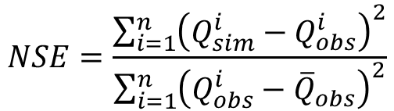
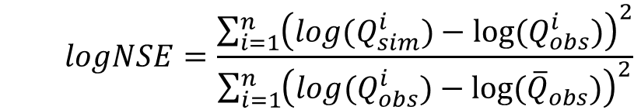
a) Single-objective/variable calibration on daily runoff data
Objective function: ME = (NSE + logNSE)/2
Nash-Sutcliffe coefficient (NSE):
$$NSE=\frac{\sum_{i=1}^{n}{{\left(Q_{sim}^{i}−Q_{obs}^{i}\right)}^{2}}}{\sum_{i=1}^{n}{{\left(Q_{obs}^{i}−{\overline{Q}}_{obs}\right)}^{2}}}$$
Logarithmic Nash-Sutcliffe coefficient (logNSE):
$$logNSE=\frac{\sum_{i=1}^{n}{{\left(log(Q_{sim}^{i})−{log⁡(Q}_{obs}^{i})\right)}^{2}}}{\sum_{i=1}^{n}{{\left({log(Q}_{obs}^{i})−{log⁡(\overline{Q}}_{obs})\right)}^{2}}}$$
The goal of the combination: to achieve a balanced evaluation of high and low flows.

Slide 9
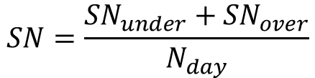
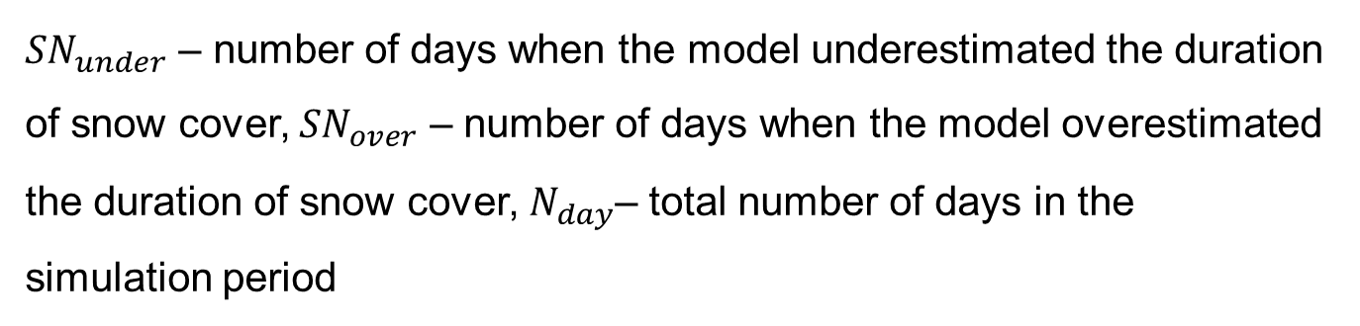
b) Multi-objective/variable calibration on daily runoff and snow cover data
Objective: to minimize the number of days when the model inaccurately simulated the duration of the snow cover.
$$SN=\frac{{SN}_{under}+{SN}_{over}}{N_{day}}$$
$${SN}_{under}=Snow depth >2 cm and SWE <0.1 mm$$
$${SN}_{over}=Snow depth <0.1 cm and SWE >2 mm$$
${SN}_{under}$ – number of days when the model underestimated the duration of snow cover, ${SN}_{over}$ – number of days when the model overestimated the duration of snow cover, $N_{day}$– total number of days in the simulation period

Slide 10
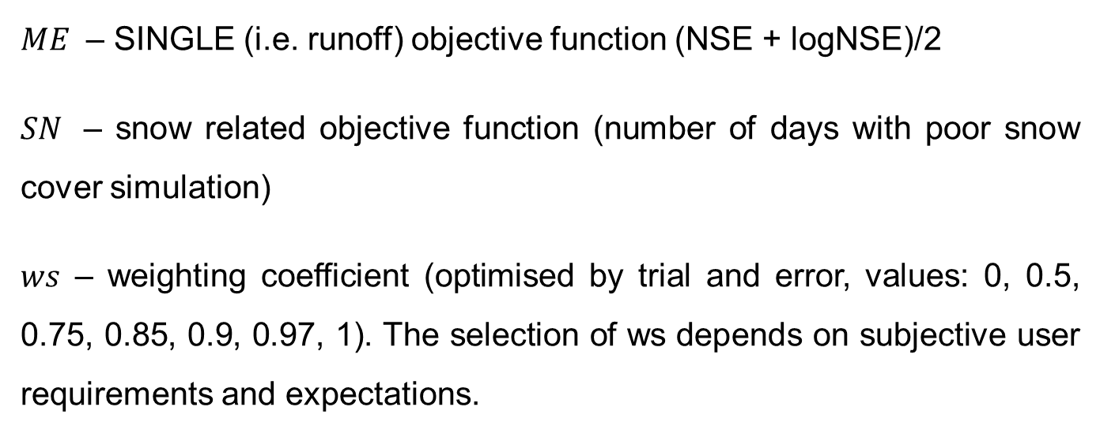
Multi-objective/variable function:
$${MULTI}_{objective}=\left(1−ws\right)∗ME+ws∗SN$$
$ME$ – SINGLE (i.e. runoff) objective function (NSE + logNSE)/2
$SN$ – snow related objective function (number of days with poor snow cover simulation)
$ws$ – weighting coefficient (optimised by trial and error, values: 0, 0.5, 0.75, 0.85, 0.9, 0.97, 1). The selection of ws depends on subjective user requirements and expectations.

Slide 11
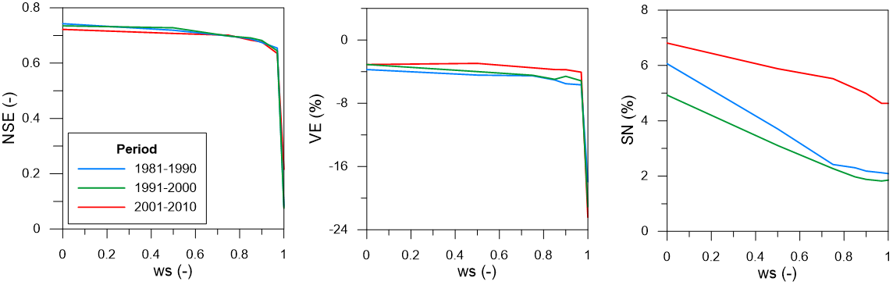
Model performance (NSE, VE, SN) for different calibration weights (i.e. ws 0, 0.5, 0.75, 0.85, 0.90, 0.97, 1) in three different calibration periods. Lines (in Fig.) represent the medians over 71 Austrian catchments.
 | NSE |  |  | VE |  |  | SN
ws | 81-90 | 91-00 | 01-10 | 81-90 | 91-00 | 01-10 | 81-90 | 91-00 | 01-10
0 | 0.74 | 0.73 | 0.72 | -3.72 | -3.09 | -3.09 | 6.06 | 4.92 | 6.81
0.5 | 0.72 | 0.72 | 0.71 | -4.43 | -3.99 | -2.94 | 3.70 | 3.10 | 5.88
0.75 | 0.70 | 0.70 | 0.70 | -4.52 | -4.45 | -3.50 | 2.42 | 2.27 | 5.25
0.85 | 0.69 | 0.69 | 0.68 | -5.04 | -4.96 | -3.73 | 2.30 | 1.97 | 5.16
0.9 | 0.67 | 0.68 | 0.67 | -5.52 | -4.58 | -3.73 | 2.20 | 1.88 | 4.99
0.97 | 0.65 | 0.64 | 0.63 | -5.65 | -5.15 | -4.05 | 2.21 | 1.82 | 4.63
1 | 0.08 | 0.07 | 0.21 | -17.94 | -21.09 | -22.42 | 2.09 | 1.85 | 4.63

Slide 12
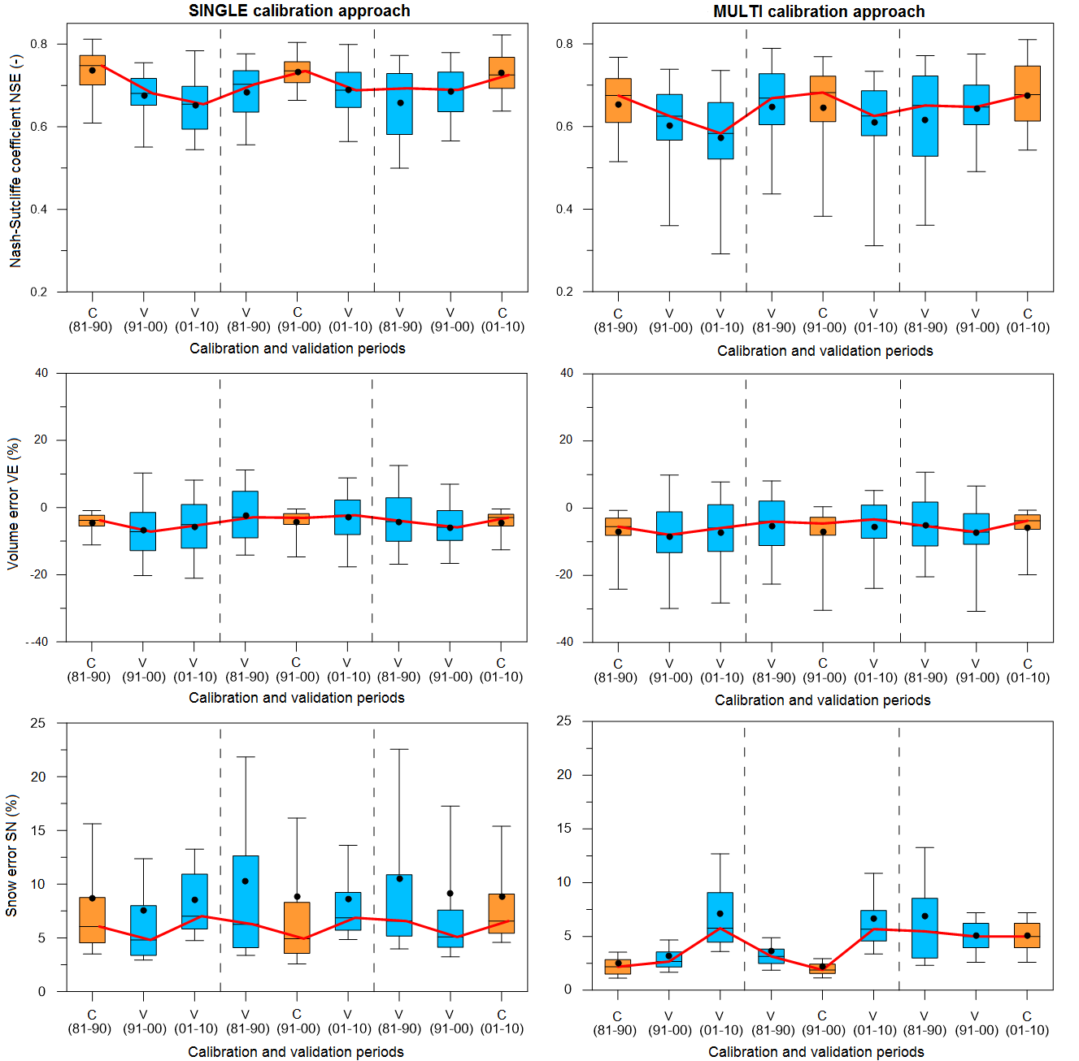

Slide 13
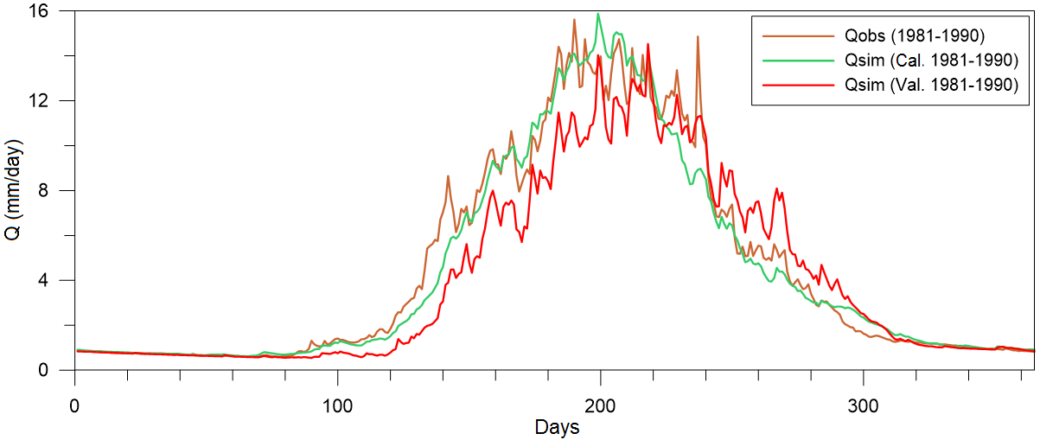
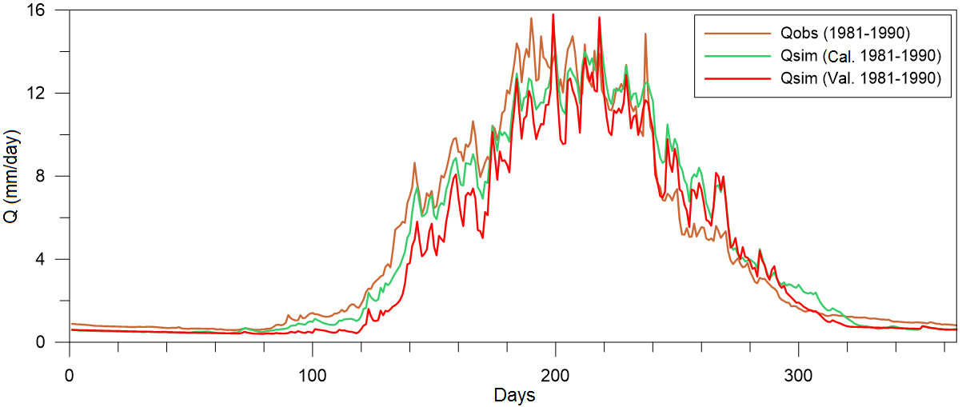
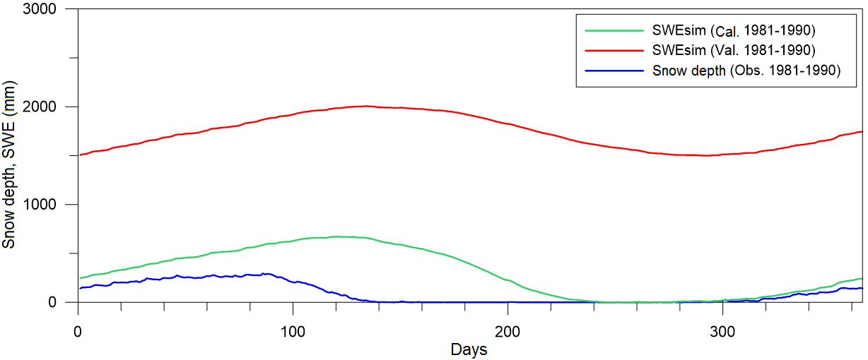
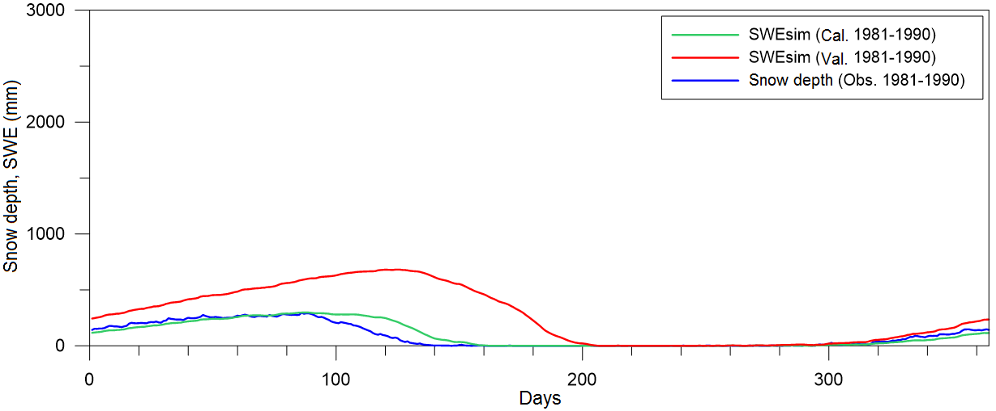
Pilot catchment: simulations of daily Q and SWE
The MULTI approach was beneficial in the simulations of the SWE (slightly poorer values in terms of simulating Q).
Fig. Observed and simulated Q (top panel, left and right) and observed Snow depth and simulated SWE (bottom panel, left and right) for one year averaged over periods 1981 – 1990 and 2001 – 2010 (SINGLE approach – left panel, MULTI approach – right panel).

Slide 14
Conclusions I.
TUW model was calibrated for three climatically contrasting periods between 1981 – 2010 for 71 alpine catchments (one selected catchment) in Austria.
Two optimization functions (SINGLE and MULTI) were designed.
The calibration results were evaluated in terms of NSE, VE, SN.
We found that:
  The model tended to systematically underestimate the volume of flows.
  The results also showed that the use of snow cover data in the calibration (the MULTI approach) improved the model performance in terms of simulating snow (i.e. SWE) (the model performance in terms of simulating runoff was slightly poorer).
  These results are in general agreement with the findings presented e.g., by Seibert, 2000; Madsen, 2003; Parajka et al., 2007.

Slide 15
Conclusions II.
The use of various data (e.g. SWE, snow cover, etc.) in multi-objective calibration can be a good way to improve representation of hydrological processes
  (e.g. in alpine regions, where data are sparse and the spatial variability of the hydrological environment is enormous).
Recommendations for practical applications of r-r models (in the climate change context) :
To re-calibrate the conceptual r-r models (e.g. type of HBV and its derivatives) if the climatic conditions change.
To consider various calibration periods and the change the model parameters depending on the hydroclimatic regime.

Slide 16
Thank you for your attention

